Slide 1
William Stallings
Computer Organization and Architecture
8th Edition
Chapter 12
Processor Structure and Function

Slide 2
CPU Structure
CPU must:
  Fetch instructions
  Interpret instructions
  Fetch data
  Process data
  Write data
Notes:
22

Slide 3
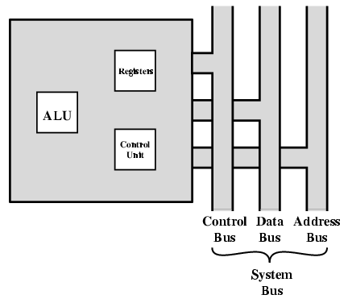
CPU With Systems Bus

Slide 4
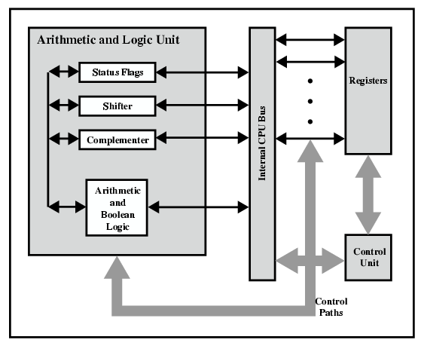
CPU Internal Structure

Slide 5
Registers
CPU must have some working space (temporary storage)
Called registers
Number and function vary between processor designs
One of the major design decisions
Top level of memory hierarchy
Notes:
23

Slide 6
User Visible Registers
General Purpose
Data
Address
Condition Codes
Notes:
24

Slide 7
General Purpose Registers (1)
May be true general purpose
May be restricted
May be used for data or addressing
Data
  Accumulator
Addressing
  Segment
Notes:
25

Slide 8
General Purpose Registers (2)
Make them general purpose
  Increase flexibility and programmer options
  Increase instruction size & complexity
Make them specialized
  Smaller (faster) instructions
  Less flexibility
Notes:
26

Slide 9
How Many GP Registers?
Between 8 - 32
Fewer = more memory references
More does not reduce memory references and takes up processor real estate
See also RISC
Notes:
27

Slide 10
How big?
Large enough to hold full address
Large enough to hold full word
Often possible to combine two data registers
  C programming
  double int a;
  long int a;
Notes:
28

Slide 11
Condition Code Registers
Sets of individual bits
  e.g. result of last operation was zero
Can be read (implicitly) by programs
  e.g. Jump if zero
Can not (usually) be set by programs
Notes:
29

Slide 12
Control & Status Registers
Program Counter
Instruction Decoding Register
Memory Address Register
Memory Buffer Register
Revision: what do these all do?
Notes:
30

Slide 13
Program Status Word
A set of bits
Includes Condition Codes
Sign of last result
Zero
Carry
Equal
Overflow
Interrupt enable/disable
Supervisor
Notes:
31

Slide 14
Supervisor Mode
Intel ring zero
Kernel mode
Allows privileged instructions to execute
Used by operating system
Not available to user programs
Notes:
32

Slide 15
Other Registers
May have registers pointing to:
  Process control blocks (see O/S)
  Interrupt Vectors (see O/S)
N.B. CPU design and operating system design are closely linked
Notes:
33

Slide 16

Example Register Organizations

Slide 17
Instruction Cycle
Revision
Stallings Chapter 3
Notes:
35

Slide 18
Indirect Cycle
May require memory access to fetch operands
Indirect addressing requires more memory accesses
Can be thought of as additional instruction subcycle

Slide 19
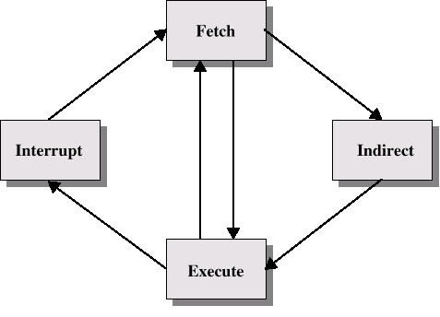
Instruction Cycle with Indirect

Slide 20

Instruction Cycle State Diagram

Slide 21
Data Flow (Instruction Fetch)
Depends on CPU design
In general:
Fetch
  PC contains address of next instruction
  Address moved to MAR
  Address placed on address bus
  Control unit requests memory read
  Result placed on data bus, copied to MBR, then to IR
  Meanwhile PC incremented by 1

Slide 22
Data Flow (Data Fetch)
IR is examined
If indirect addressing, indirect cycle is performed
  Right most N bits of MBR transferred to MAR
  Control unit requests memory read
  Result (address of operand) moved to MBR

Slide 23

Data Flow (Fetch Diagram)

Slide 24

Data Flow (Indirect Diagram)

Slide 25
Data Flow (Execute)
May take many forms
Depends on instruction being executed
May include
  Memory read/write
  Input/Output
  Register transfers
  ALU operations

Slide 26
Data Flow (Interrupt)
Simple
Predictable
Current PC saved to allow resumption after interrupt
Contents of PC copied to MBR
Special memory location (e.g. stack pointer) loaded to MAR
MBR written to memory
PC loaded with address of interrupt handling routine
Next instruction (first of interrupt handler) can be fetched

Slide 27

Data Flow (Interrupt Diagram)

Slide 28
Prefetch
Fetch accessing main memory
Execution usually does not access main memory
Can fetch next instruction during execution of current instruction
Called instruction prefetch
Notes:
36

Slide 29
Improved Performance
But not doubled:
  Fetch usually shorter than execution
    Prefetch more than one instruction?
  Any jump or branch means that prefetched instructions are not the required instructions
Add more stages to improve performance
Notes:
37

Slide 30
Pipelining
Fetch instruction
Decode instruction
Calculate operands (i.e. EAs)
Fetch operands
Execute instructions
Write result
Overlap these operations
Notes:
38

Slide 31
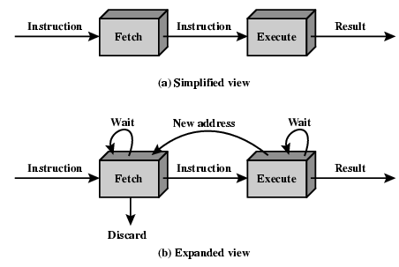
Two Stage Instruction Pipeline

Slide 32
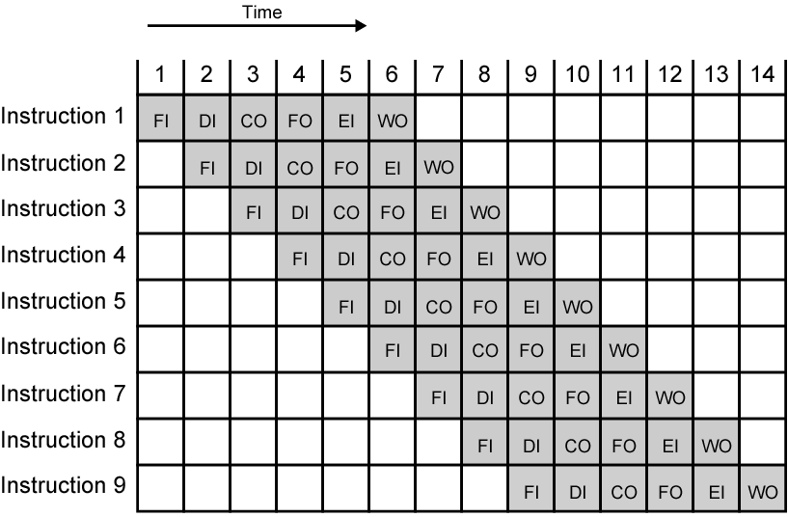
Timing Diagram for
Instruction Pipeline Operation
Notes:
39

Slide 33
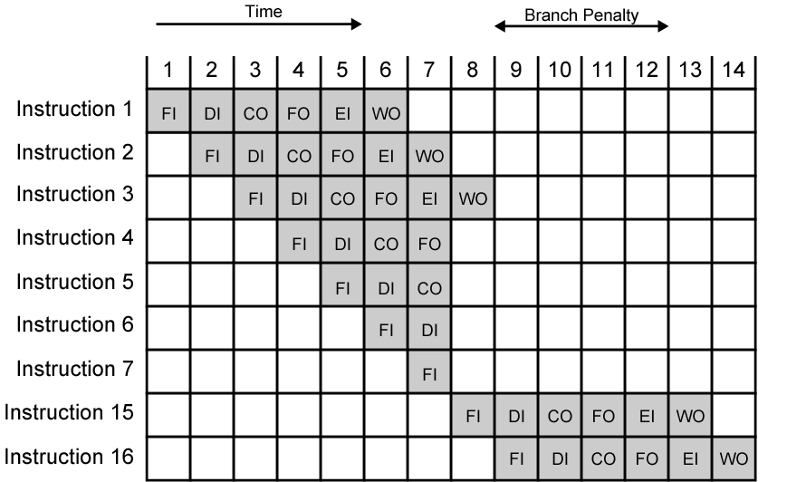
The Effect of a Conditional Branch on Instruction Pipeline Operation
Notes:
40

Slide 34
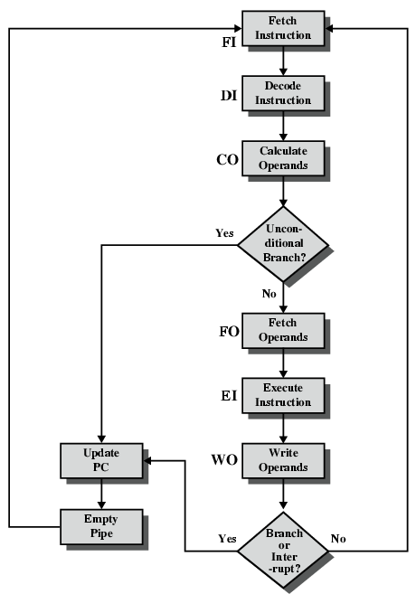
Six Stage
Instruction Pipeline

Slide 35
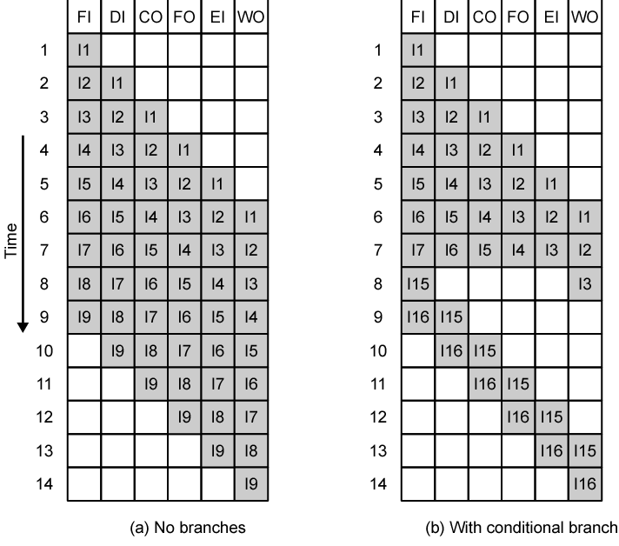
Alternative Pipeline Depiction

Slide 36
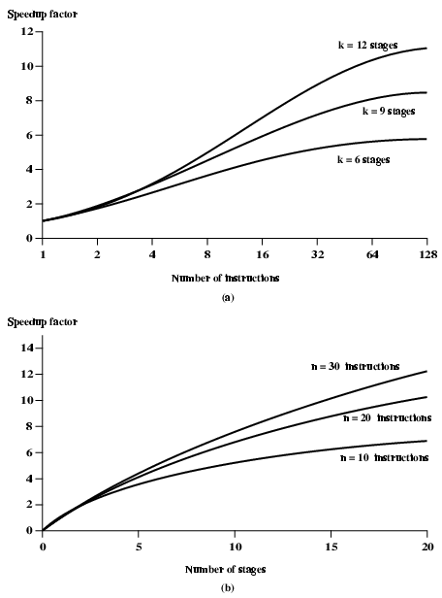
Speedup Factors with Instruction
Pipelining

Slide 37
Pipeline Hazards
Pipeline, or some portion of pipeline, must stall
Also called pipeline bubble
Types of hazards
  Resource
  Data
  Control

Slide 38
Resource Hazards
Two (or more) instructions in pipeline need same resource
Executed in serial rather than parallel for part of pipeline
Also called structural hazard
E.g. Assume simplified five-stage pipeline
  Each stage takes one clock cycle
Ideal case is new instruction enters pipeline each clock cycle
Assume main memory has single port
Assume instruction fetches and data reads and writes performed one at a time
Ignore the cache
Operand read or write cannot be performed in parallel with instruction fetch
Fetch instruction stage must idle for one cycle fetching I3
E.g. multiple instructions ready to enter execute instruction phase
Single ALU
One solution: increase available resources
  Multiple main memory ports
  Multiple ALUs

Slide 39

Data Hazards
Conflict in access of an operand location
Two instructions to be executed in sequence
Both access a particular memory or register operand
If in strict sequence, no problem occurs
If in a pipeline, operand value could be updated so as to produce different result from strict sequential execution
E.g. x86 machine instruction sequence:
ADD EAX, EBX /* EAX = EAX + EBX
SUB ECX, EAX /* ECX = ECX – EAX
ADD instruction does not update EAX until end of stage 5, at clock cycle 5
SUB instruction needs value at beginning of its stage 2, at clock cycle 4
Pipeline must stall for two clocks cycles
Without special hardware and specific avoidance algorithms, results in inefficient pipeline usage

Slide 40
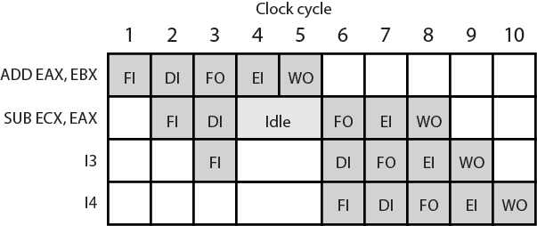
Data Hazard Diagram

Slide 41
Types of Data Hazard
Read after write (RAW), or true dependency
  An instruction modifies a register or memory location
  Succeeding instruction reads data in that location
  Hazard if read takes place before write complete
Write after read (RAW), or antidependency
  An instruction reads a register or memory location
  Succeeding instruction writes to location
  Hazard if write completes before read takes place
Write after write (RAW), or output dependency
  Two instructions both write to same location
  Hazard if writes take place in reverse of order intended sequence
Previous example is RAW hazard
See also Chapter 14

Slide 42
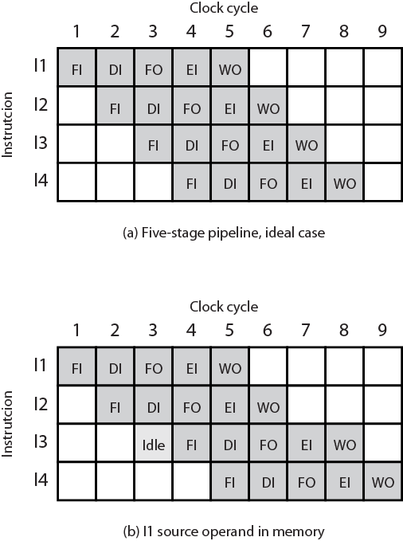
Resource Hazard Diagram

Slide 43
Control Hazard

Slide 44
Control Hazard
Also known as branch hazard
Pipeline makes wrong decision on branch prediction
Brings instructions into pipeline that must subsequently be discarded
Dealing with Branches
  Multiple Streams
  Prefetch Branch Target
  Loop buffer
  Branch prediction
  Delayed branching
Notes:
41

Slide 45
Multiple Streams
Have two pipelines
Prefetch each branch into a separate pipeline
Use appropriate pipeline
Leads to bus & register contention
Multiple branches lead to further pipelines being needed
Notes:
42

Slide 46
Prefetch Branch Target
Target of branch is prefetched in addition to instructions following branch
Keep target until branch is executed
Used by IBM 360/91
Notes:
43

Slide 47
Loop Buffer
Very fast memory
Maintained by fetch stage of pipeline
Check buffer before fetching from memory
Very good for small loops or jumps
c.f. cache
Used by CRAY-1
Notes:
44

Slide 48
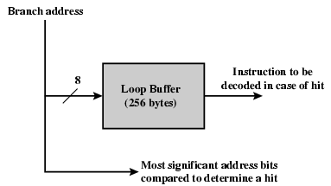
Loop Buffer Diagram

Slide 49
Branch Prediction (1)
Predict never taken
  Assume that jump will not happen
  Always fetch next instruction
  68020 & VAX 11/780
  VAX will not prefetch after branch if a page fault would result (O/S v CPU design)
Predict always taken
  Assume that jump will happen
  Always fetch target instruction
Notes:
45

Slide 50
Branch Prediction (2)
Predict by Opcode
  Some instructions are more likely to result in a jump than thers
  Can get up to 75% success
Taken/Not taken switch
  Based on previous history
  Good for loops
  Refined by two-level or correlation-based branch history
Correlation-based
  In loop-closing branches, history is good predictor
  In more complex structures, branch direction correlates with that of related branches
    Use recent branch history as well
Notes:
46

Slide 51
Branch Prediction (3)
Delayed Branch
  Do not take jump until you have to
  Rearrange instructions
Notes:
47

Slide 52
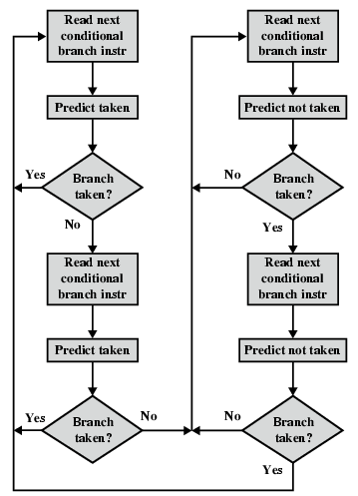
Branch Prediction Flowchart

Slide 53
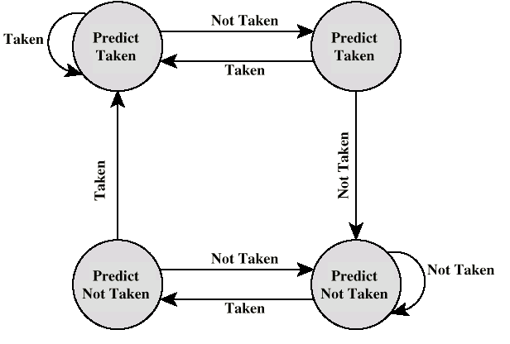
Branch Prediction State Diagram

Slide 54
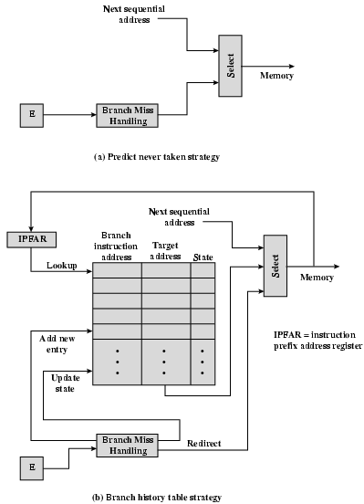
Dealing With
Branches

Slide 55
Intel 80486 Pipelining
Fetch
  From cache or external memory
  Put in one of two 16-byte prefetch buffers
  Fill buffer with new data as soon as old data consumed
  Average 5 instructions fetched per load
  Independent of other stages to keep buffers full
Decode stage 1
  Opcode & address-mode info
  At most first 3 bytes of instruction
  Can direct D2 stage to get rest of instruction
Decode stage 2
  Expand opcode into control signals
  Computation of complex address modes
Execute
  ALU operations, cache access, register update
Writeback
  Update registers & flags
  Results sent to cache & bus interface write buffers

Slide 56
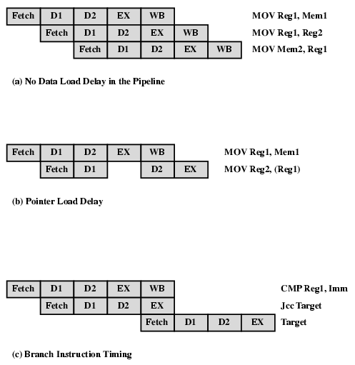
80486 Instruction Pipeline Examples

Slide 57
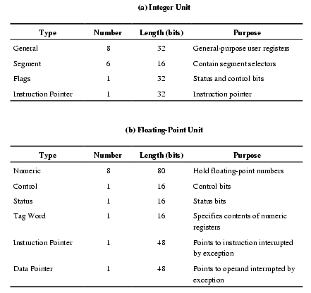
Pentium 4 Registers

Slide 58
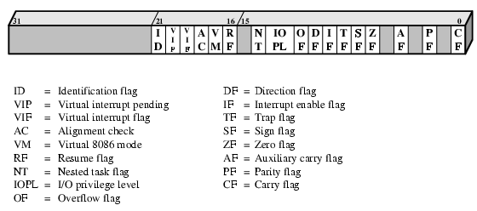
EFLAGS Register

Slide 59
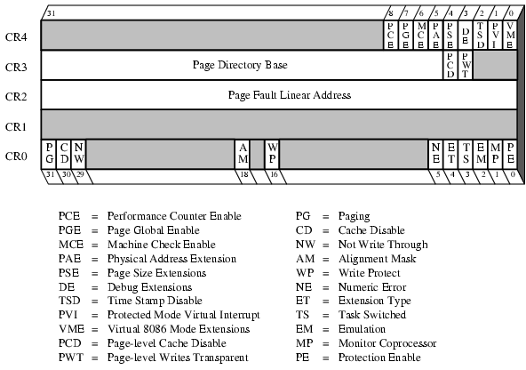
Control Registers

Slide 60
MMX Register Mapping
MMX uses several 64 bit data types
Use 3 bit register address fields
  8 registers
No MMX specific registers
  Aliasing to lower 64 bits of existing floating point registers

Slide 61
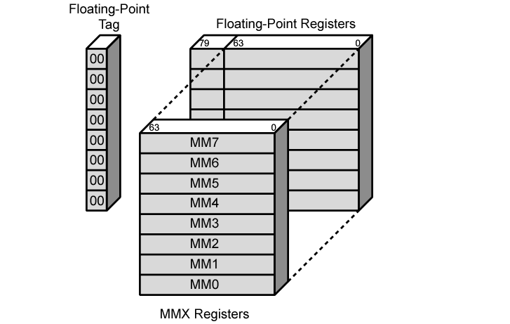
Mapping of MMX Registers to
Floating-Point Registers

Slide 62
Pentium Interrupt Processing
Interrupts
  Maskable
  Nonmaskable
Exceptions
  Processor detected
  Programmed
Interrupt vector table
  Each interrupt type assigned a number
  Index to vector table
  256 * 32 bit interrupt vectors
5 priority classes

Slide 63
ARM Attributes
RISC
Moderate array of uniform registers
  More than most CISC, less than many RISC
Load/store model
  Operations perform on operands in registers only
Uniform fixed-length instruction
  32 bits standard set 16 bits Thumb
Shift or rotation can preprocess source registers
  Separate ALU and shifter units
Small number of addressing modes
  All load/store addressees from registers and instruction fields
  No indirect or indexed addressing involving values in memory
Auto-increment and auto-decrement addressing
  Improve loops
Conditional execution of instructions minimizes conditional branches
  Pipeline flushing is reduced

Slide 64
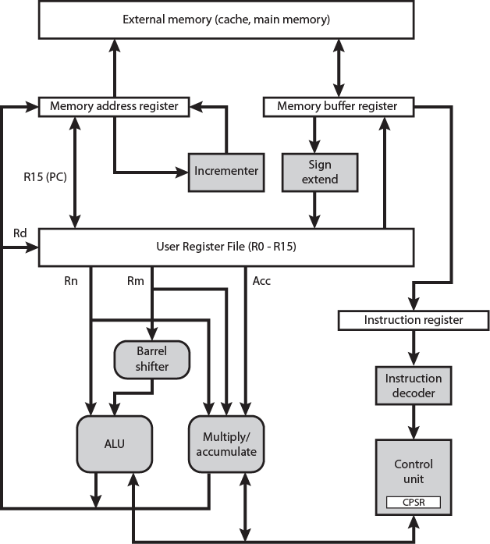
Simplified ARM Organization

Slide 65
ARM Processor Organization
Many variations depending on ARM version
Data exchanged between processor and memory through data bus
Data item (load/store) or instruction (fetch)
Instructions go through decoder before execution
Pipeline and control signal generation in control unit
Data goes to register file
  Set of 32 bit registers
  Byte & halfword twos complement data sign extended
Typically two source and one result register
Rotation or shift before ALU

Slide 66
ARM Processor Modes
User
Privileged
  6 modes
    OS can tailor systems software use
    Some registers dedicated to each privileged mode
    Swifter context changes
Exception
  5 of privileged modes
  Entered on given exceptions
  Substitute some registers for user registers
    Avoid corruption

Slide 67
Privileged Modes
System Mode
  Not exception
  Uses same registers as User mode
  Can be interrupted by…
Supervisor mode
  OS
  Software interrupt usedd to invoke operating system services
Abort mode
  memory faults
Undefined mode
  Attempt instruction that is not supported by integer core coprocessors
Fast interrupt mode
  Interrupt signal from designated fast interrupt source
  Fast interrupt cannot be interrupted
  May interrupt normal interrupt
Interrupt mode
Interrupt signal from any other interrupt source

Slide 68
ARM
Register
Organization
Table
 | Modes
 |  | Privileged modes
 |  | Exception modes
User | System | Supervisor | Abort | Undefined | Interrupt | Fast Interrupt
R0 | R0 | R0 | R0 | R0 | R0 | R0
R1 | R1 | R1 | R1 | R1 | R1 | R1
R2 | R2 | R2 | R2 | R2 | R2 | R2
R3 | R3 | R3 | R3 | R3 | R3 | R3
R4 | R4 | R4 | R4 | R4 | R4 | R4
R5 | R5 | R5 | R5 | R5 | R5 | R5
R6 | R6 | R6 | R6 | R6 | R6 | R6
R7 | R7 | R7 | R7 | R7 | R7 | R7
R8 | R8 | R8 | R8 | R8 | R8 | R8_fiq
R9 | R9 | R9 | R9 | R9 | R9 | R9_fiq
R10 | R10 | R10 | R10 | R10 | R10 | R10_fiq
R11 | R11 | R11 | R11 | R11 | R11 | R11_fiq
R12 | R12 | R12 | R12 | R12 | R12 | R12_fiq
R13 (SP) | R13 (SP) | R13_svc | R13_abt | R13_und | R13_irq | R13_fiq
R14 (LR) | R14 (LR) | R14_svc | R14_abt | R14_und | R14_irq | R14_fiq
R15 (PC) | R15 (PC) | R15 (PC) | R15 (PC) | R15 (PC) | R15 (PC) | R15 (PC)
CPSR | CPSR | CPSR | CPSR | CPSR | CPSR | CPSR
 |  | SPSR_svc | SPSR_abt | SPSR_und | SPSR_irq | SPSR_fiq

Slide 69
ARM Register Organization
37 x 32-bit registers
31 general-purpose registers
  Some have special purposes
  E.g. program counters
Six program status registers
Registers in partially overlapping banks
  Processor mode determines bank
16 numbered registers and one or two program status registers visible

Slide 70
General Register Usage
R13 normally stack pointer (SP)
  Each exception mode has its own R13
R14 link register (LR)
  Subroutine and exception mode return address
R15 program counter

Slide 71
CPSR
CPSR process status register
  Exception modes have dedicated SPSR
16 msb are user flags
  Condition codes (N,Z,C,V)
  Q – overflow or saturation in some SMID instructions
  J – Jazelle (8 bit) instructions
  GEE[3:0] SMID use [19:16] as greater than or equal flag
16 lsb system flags for privilege modes
  E – endian
  Interrupt disable
  T – Normal or Thumb instruction
  Mode

Slide 72
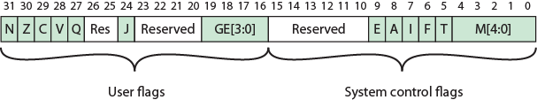
ARM CPSR and SPSR

Slide 73
ARM Interrupt (Exception) Processing
More than one exception allowed
Seven types
Execution forced from exception vectors
Multiple exceptions handled in priority order
Processor halts execution after current instruction
Processor state preserved in SPSR for exception
  Address of instruction about to execute put in link register
  Return by moving SPSR to CPSR and R14 to PC

Slide 74
Foreground Reading
Processor examples
Stallings Chapter 12
Manufacturer web sites & specs
Notes:
48

